Slide 1
The Voyage of Volvox
BY: Afrin MIrza, Donovan Delaney, Lillian Ramos, Tyler Crossland

Slide 2
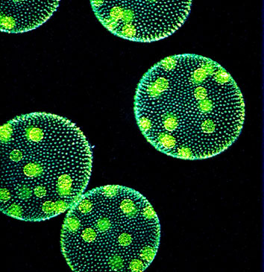
Volvox Visual
Mature Colony Flagella
Individual cell
Daughter colony

Slide 3
Processes of the Parts
Mature Colony: All of the immature colonies live in the mature colony.
Individual Cell: What works together to move the Flagella.
Daughter Colony: What reproduces asexually in a Volvox.
Flagella: The flagella help the mature colony to swim and move.

Slide 4
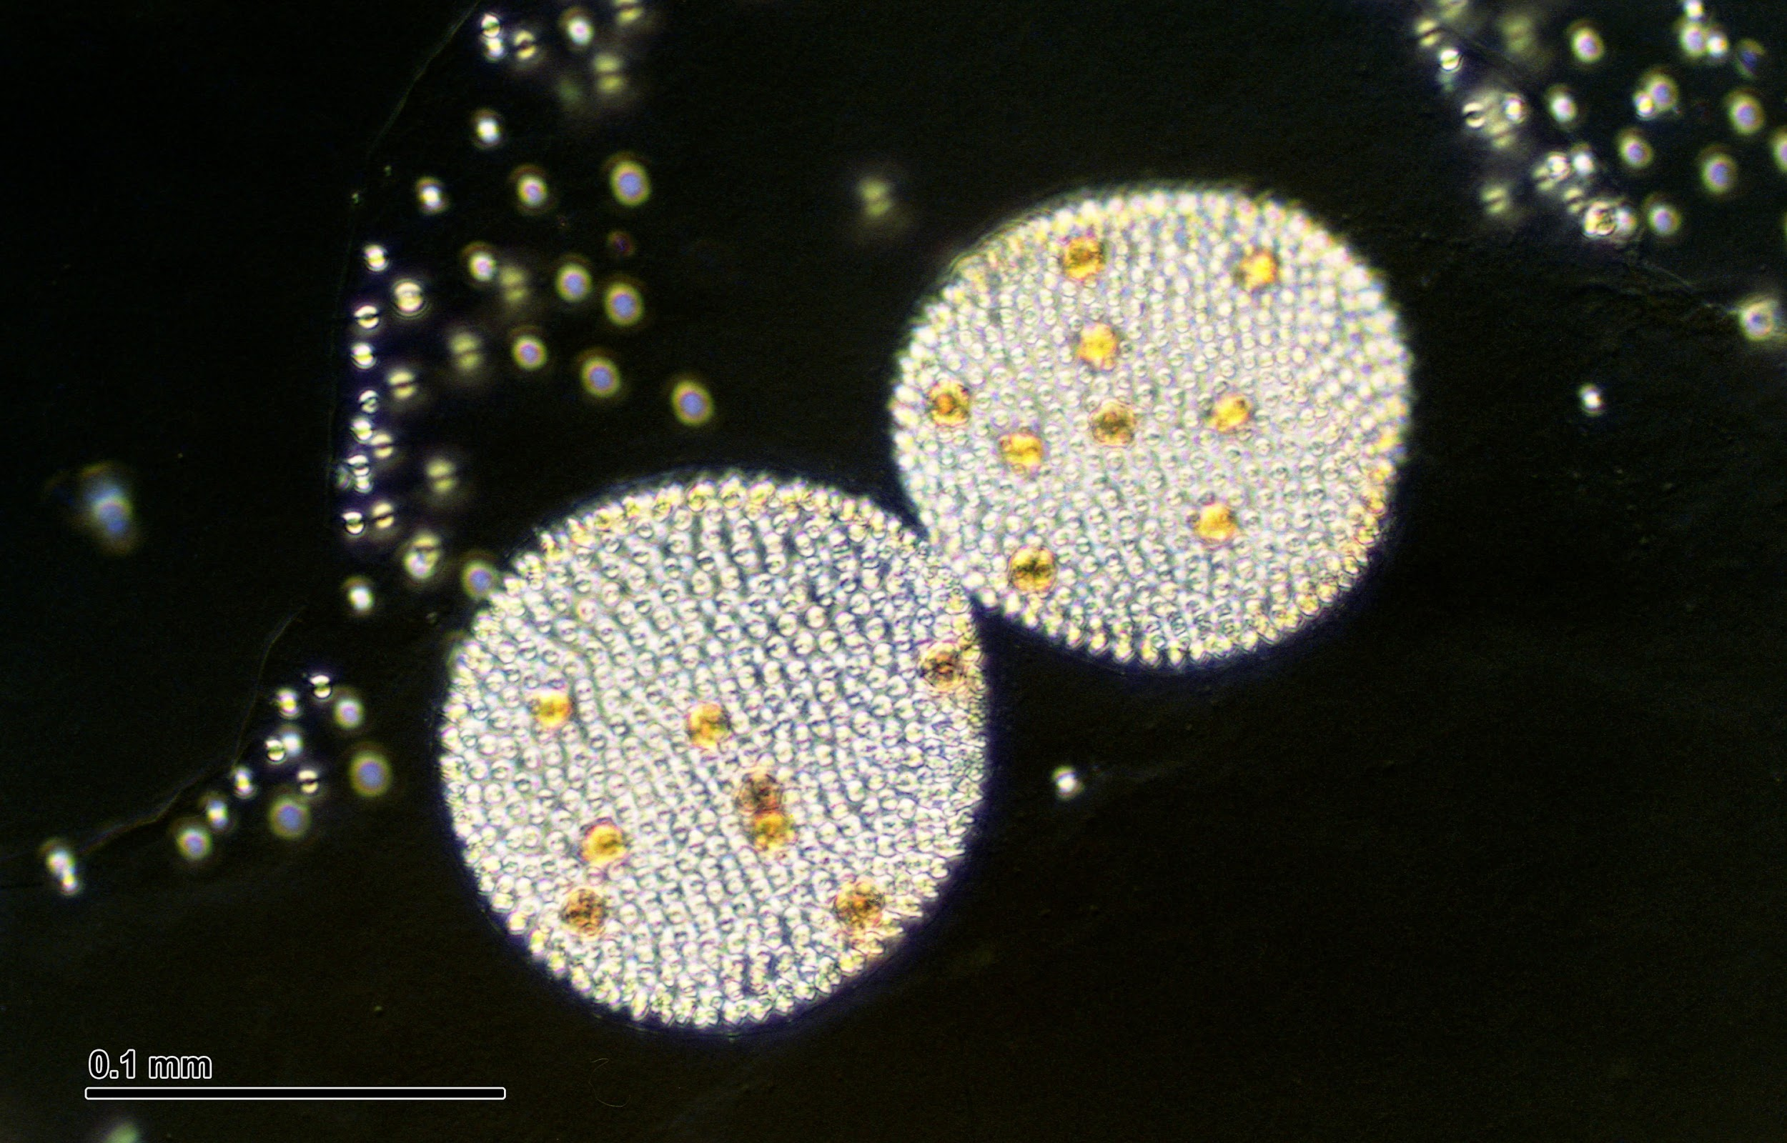
Interesting Facts
Volvox have eyespots which help them see light.
Volvox can reproduce sexually and asexually.
Volvox are like both plants and animals.
Volvox are green algae.
Antonie Van Leeuwenhoek first reported observations of volvox in 1700s
Volvox are multicellular.

Slide 5
Why You Should Come?
We include custom games based around volvox that are very exciting.
You could learn interesting facts that you didn't know before.
They are one of the few algae that are both plant-like and animal-like.
We have protection so the Volvox will not harm you.
Plus who wouldn’t want to see the weirdest algae.

Slide 6
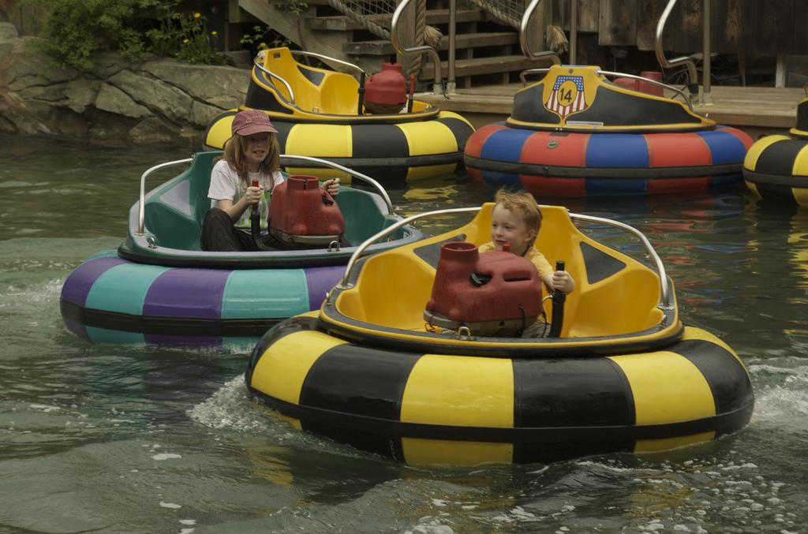
Volvox Bumper Boats
Volvox Bumper Boats includes fun for everyone 5 and up.The boats are made so they resemble a volvox. They also move in the same patterns of a volvox...SPINNING. This is all located in our huge pool decorated to resemble a pond.

Slide 7
Volvox Spin cycle
This awesome game is for your entire family. However, children younger than 3 years old are not allowed on the ride. The Volvox Spin Cycle is a circular seat that glides in the water with up to 7 seats. It is supposed to be a volvox and you and your family can be the individual cells and there will be 16 pairs of rubber flagella that move you around as if you were a volvox.

Slide 8
What Will it be Like
So now you know why to come, do you know what to expect? When you walk in there will be 5 cylinder tanks that contain 100 Volvox each. It will have magnified glass so there is no need for a microscope and so you can see it because the volvox are really small. They all will be in 5 tanks that have very thick magnifying glass so that no one can break the glass. Also, since Volvox make their own food there will be no need to supply them with food. Our custodians will keep the glass clean as possible so that no germs are being spread and the way out the door, 2 worker will be standing with hand sanitizers. We will do our best to make sure you enjoy these cool creatures and stay germ free.

Slide 9
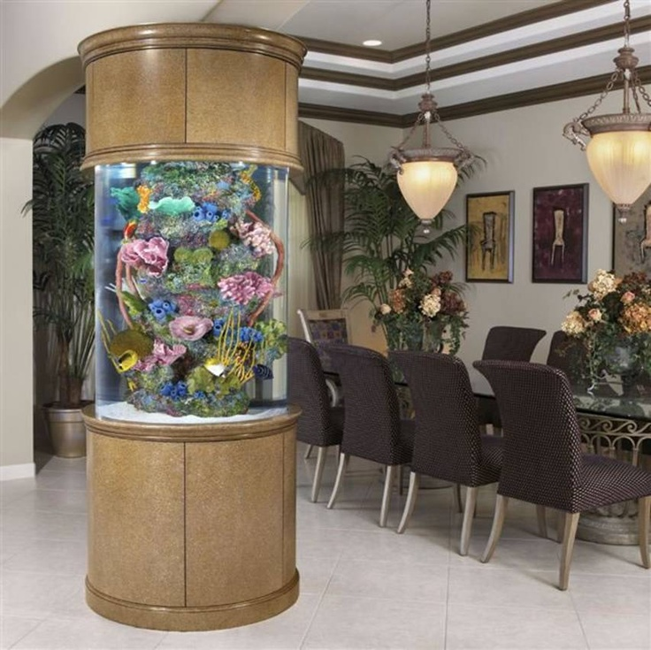
How Will You Learn Info About Volvox
Volvox are so much fun to learn about. But, how will you learn about Volvox you ask? Well our Volvox experts will be next to each tank answering every question you have about the volvox. We will also have a information square on the granite part of the tank that gives you many fun facts and a lot of other cool information.

Slide 10
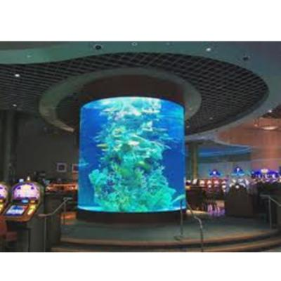
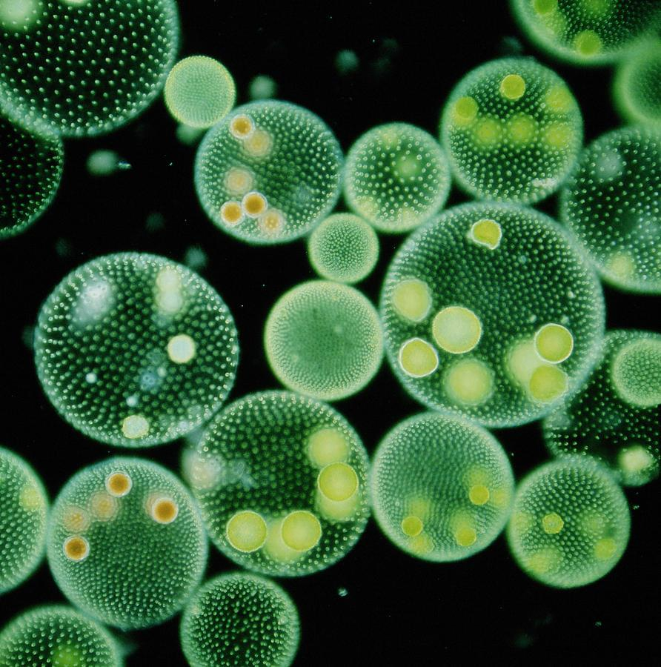
So Come On Down To The Coolest Volvox Aquarium
So Bring Your Family and Friends To The Volvox Exhibit
And Experience Joy and Information!!!!

Slide 11
By: Afrin Mirza, Donovon Delaney, Tyler Crossland, Lillian Ramos

